Slide 1
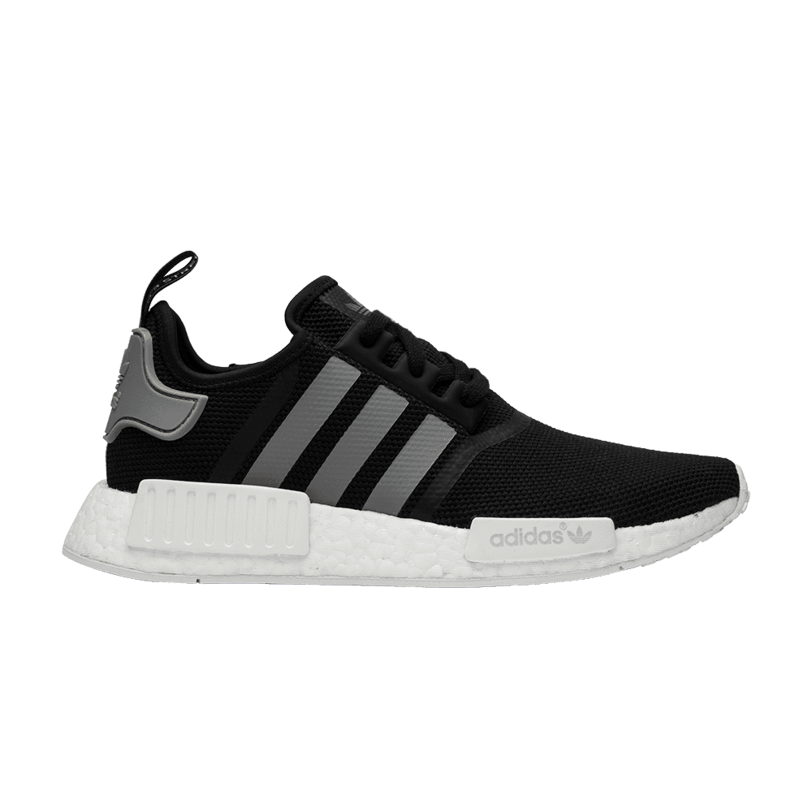
Sales Performance Analysis of Adidas Store vs Outlet vs Online (2020-2021)
Presented by: Farhah
Last Updated: July 29, 2025

Slide 2
Key Steps:
01
Purpose & Business Questions
02
About Data
03
Insights & Patterns from the Data
04
Conclusion
05
Strategic Recomendations

Slide 3
What Are We Talking About ?

Slide 4

Purpose & Bussiness ASK
This study aims to gain strategic insights by comparing Adidas’ sales performance across Store, Outlet, and Online channels, in order to enhance operational efficiency, profitability, and the effectiveness of sales strategies in the U.S. market.
Bussines Ask:
How does Adidas’ sales performance differ across the Store, Outlet, and Online sales methods?
Which products or categories are the most profitable and best-selling in each sales channel?
What strategies can be implemented to improve sales profitability and operational efficiency based on the analysis?

Slide 5
About Data
Data Sourse
Data Details
Data Content & Values
This analysis uses Adidas US Sales Data (2020–2021) from Kaggle. It includes actual retail transactions from Store, Outlet, and Online channels in the U.S.
Each entry includes date, location, product, price, units sold, total sales, profit, and margin. It captures multi-channel sales data across thousands of transactions.
Data is reliable, original, and comprehensive. It enables analysis of trends, product performance, and sales strategy. Publicly available and anonymized for safe use.

Slide 6

Present Data

Slide 7
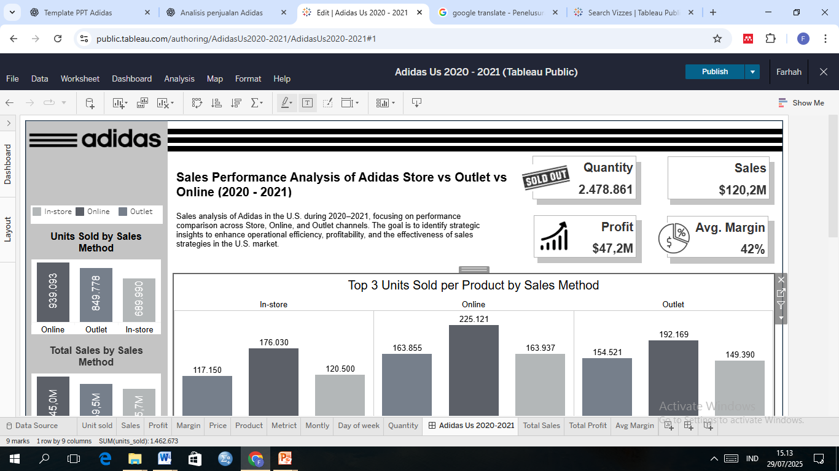
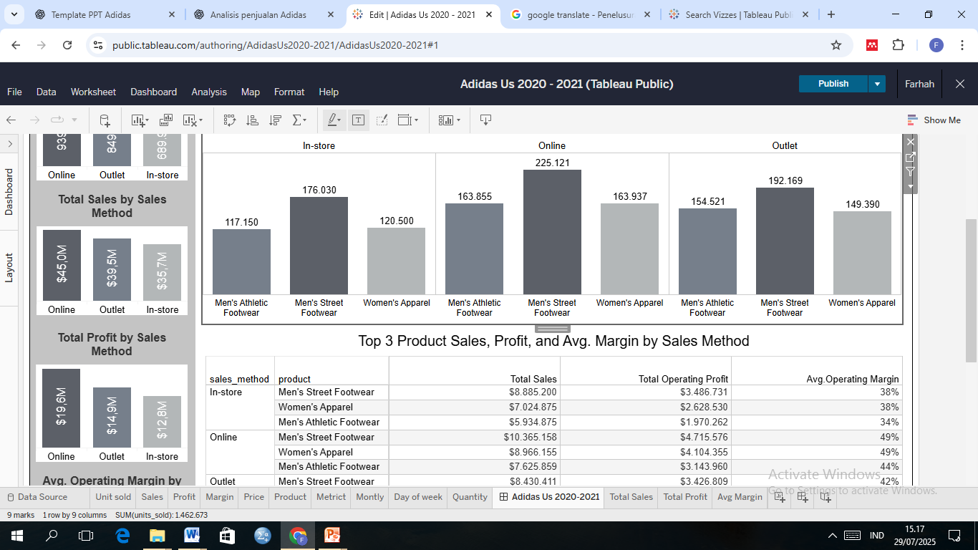
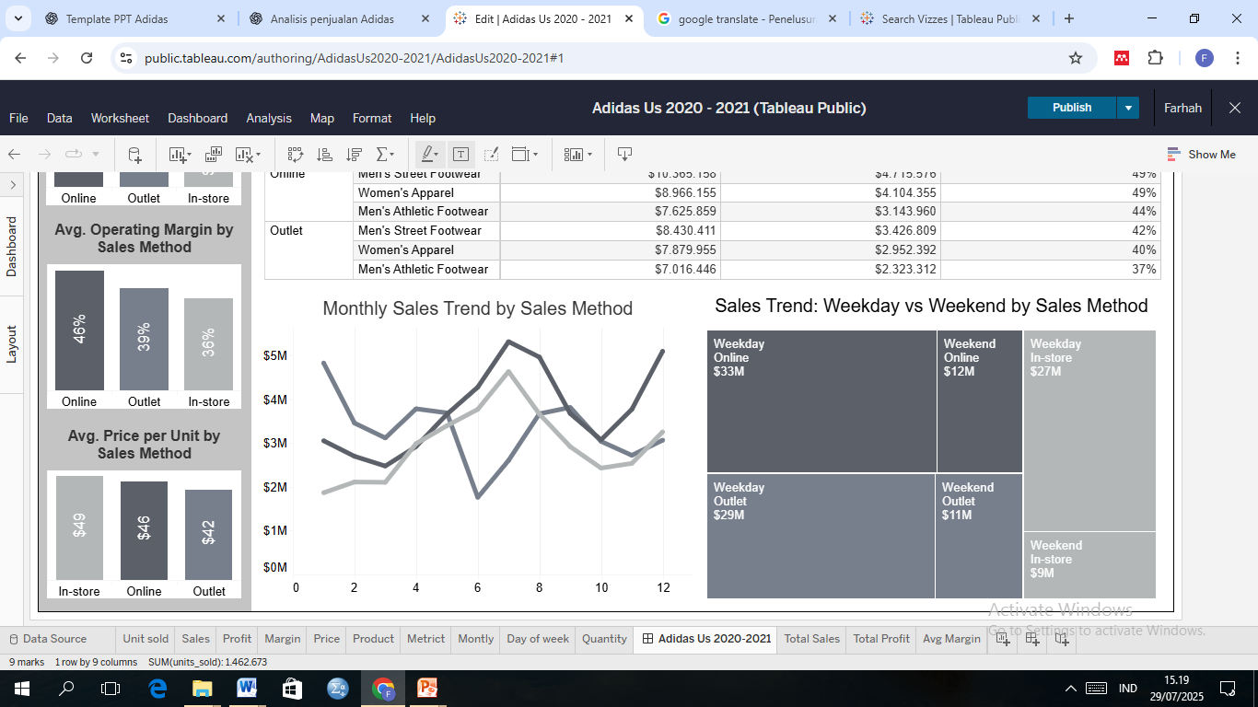


Sales Performance by Channel
Adidas sales data (2020–2021) shows Online as the top-performing channel in units sold, revenue, profit, and margin. Outlet performs well in volume and profit despite lower prices, while In-store lags due to higher costs and lower margins. This highlights Online as the core growth driver, with Outlet as a strong support and In-store needing strategic improvements.

Slide 8
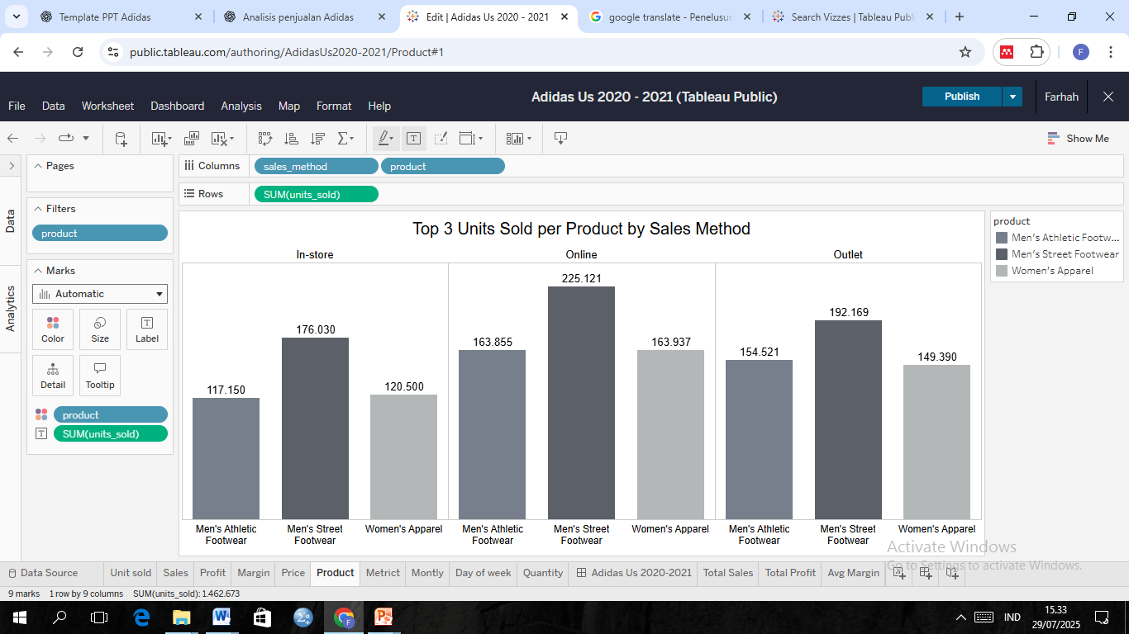
Top 3 Units Sold per Product by Sales Method
During 2020–2021, Adidas’ top three best-selling products were Men’s Street Footwear, Men’s Athletic Footwear, and Women’s Apparel, with the highest sales through the Online channel, followed by Outlet and In-store. This indicates a shift in consumer behavior towards digital shopping and highlights the strategic importance of the Online channel in Adidas’ sales strategy.

Slide 9
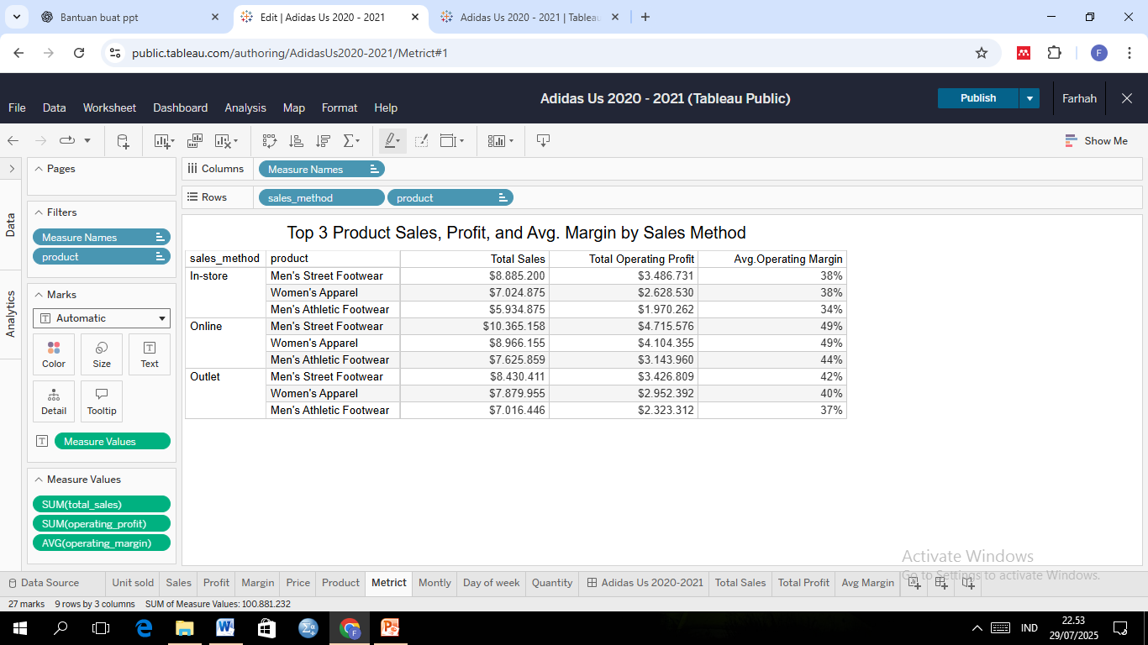
Top 3 Product Sales, Profit, and Avg. Margin by Sales Method
In 2020–2021, the Online channel led in sales, profit, and margin, driven by Men’s Street Footwear, Women’s Apparel, and Men’s Athletic Footwear. Outlet performed well with high volume and moderate profit, while In-store had the highest prices but lowest margins due to higher costs. Across all channels, Men’s Street Footwear and Women’s Apparel were the most profitable. These results confirm the strategic value of the Online channel and key product categories in driving growth.

Slide 10
Monthly Sales Trend by Sales Method
During 2020–2021, the Online channel led monthly sales with a mid-to-late year surge driven by promotions and digital shopping trends. Outlet contributed significantly but showed fluctuations, being sensitive to seasonality and inventory. In-store had the lowest sales but remained stable, peaking in July. This pattern highlights the dominance of digital channels and the need for inventory efficiency in Outlets and differentiation in physical stores.
Month

Slide 11
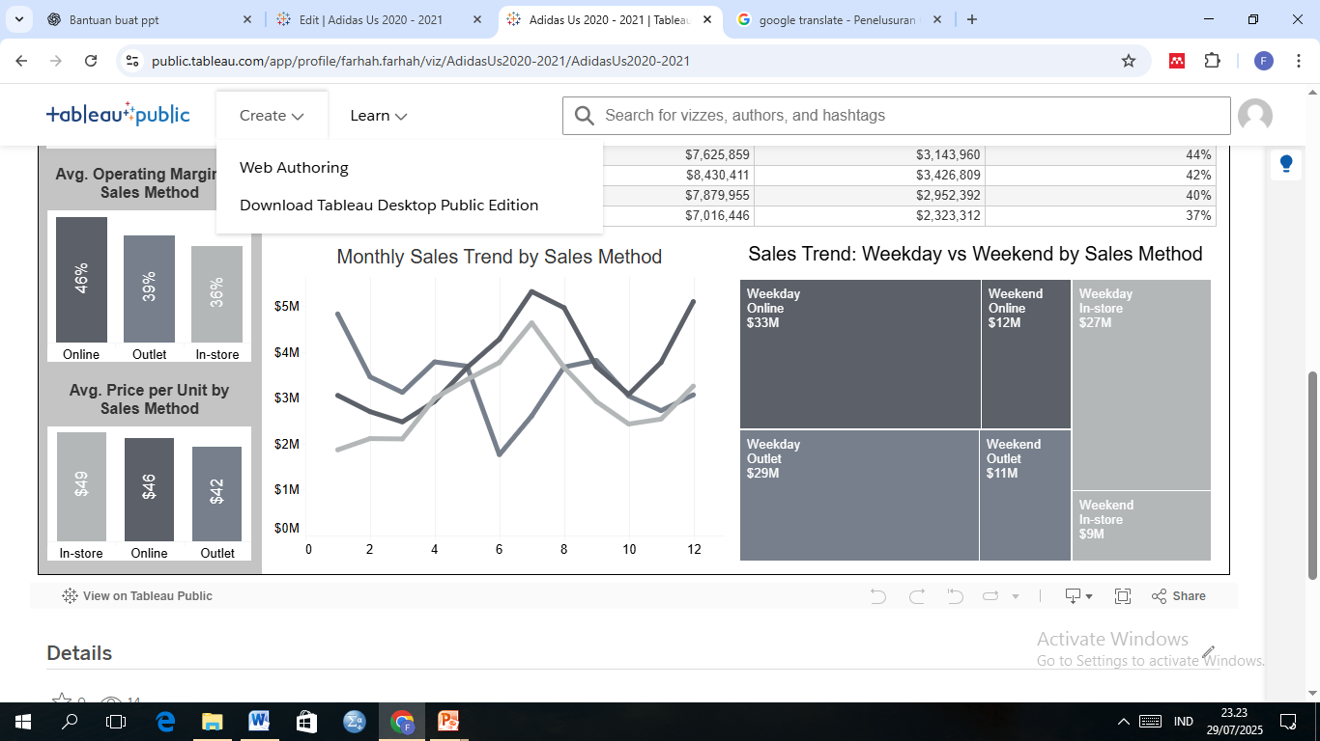
Sales Trend: Weekday vs Weekend by Sales Method
During 2020–2021, Adidas sales were higher on weekdays across all channels. Online led both weekdays ($32.87M) and weekends ($12.10M), followed by Outlet and In-store. This trend indicates that consumers were more active during weekdays, especially through digital channels. These insights are essential for optimizing promotional timing and channel strategies.

Slide 12
Conclusion

Slide 13
Sales Performance by Method
Online is the most efficient and profitable channel (46% margin), with the highest and most stable sales, driven by digital shopping trends.
Outlet drives large volume through discounts, with moderate profitability but higher fluctuation.
In-store has the highest unit price but the lowest margin (36%) and profit, due to high operational costs.
Men’s Street Footwear is the best-selling and most profitable product across all channels.
Women’s Apparel and Men’s Athletic Footwear also perform strongly, especially in Online and Outlet channels.
Apparel leans toward premium pricing with high margins, while footwear excels in volume.
Top Performing Products

Slide 14
Strategic Recomendations
Online: Prioritize high-margin products (e.g., Men’s Street Footwear & Women’s Apparel), leverage data analytics for personalized offers and effective promotions, and enhance logistics and user experience to boost conversions and customer satisfaction.
Outlet: Maximize as a stock clearance channel through planned discounts and fast inventory rotation, focusing on products like Men’s Athletic Footwear and Women’s Street Footwear.
In-store: Position physical stores as brand experience centers by featuring premium and exclusive products, and integrate technologies like AR to increase engagement and in-store purchases.

Slide 15
Thanks

